Slide 1

Introduction to Data Science

Slide 2




Course content
Introduction to Data Science
The Data Science Components
Applications of Data Science
Types of Data Science jobs
Skills and Tools for Data Science
Data Science Lifecycle

Slide 3
What is Data Science?
Data science is an interdisciplinary field that involves the extraction of knowledge, insights, and actionable information from large and complex datasets.
It combines various techniques and methodologies from statistics, computer science, mathematics, domain expertise, and domain-specific knowledge to analyze data and solve complex problems.
The main goal of data science is to uncover meaningful patterns, trends, and insights from data, and to use these insights to make informed decisions, build predictive models, and drive innovation.

Slide 4
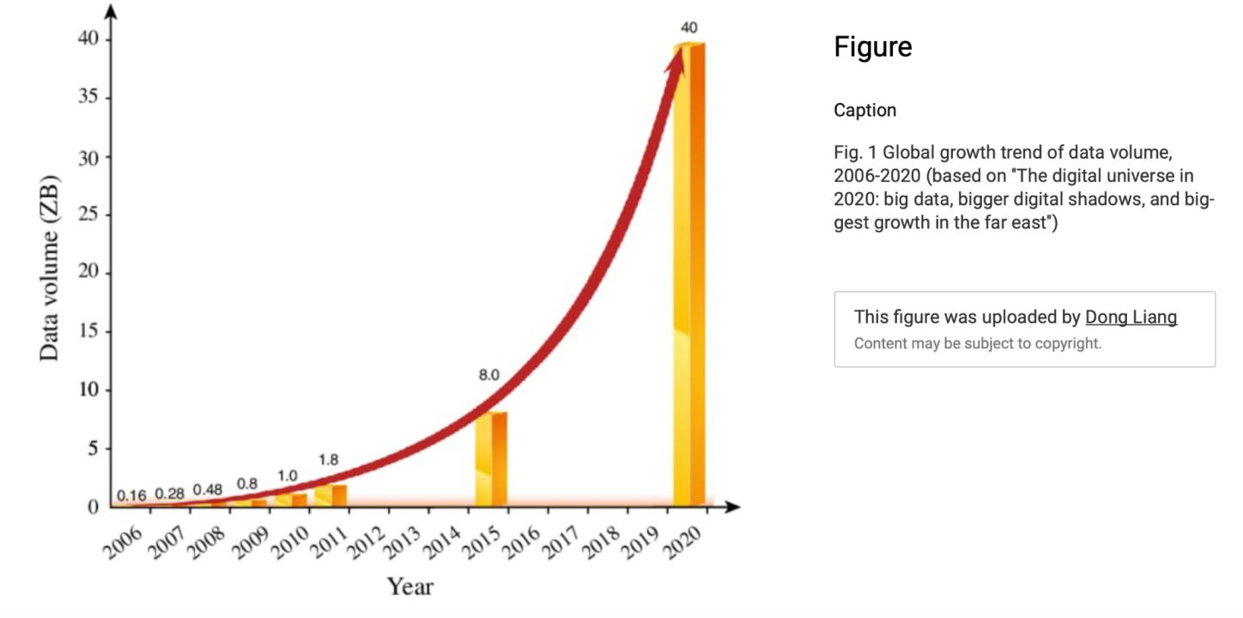
Why are we talking about data now?

Slide 5
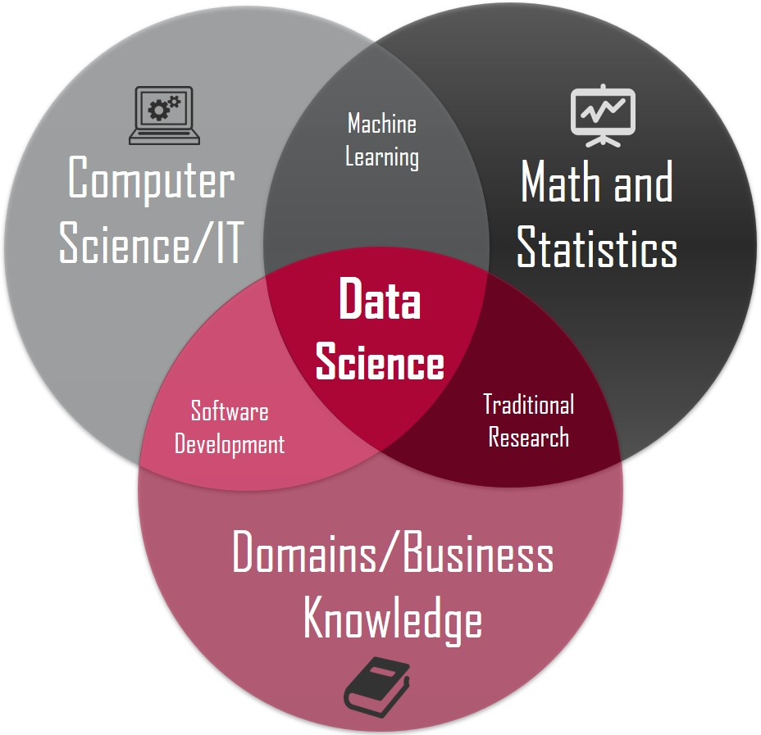
Components of Data science

Slide 6
Applications of Data Science
1.Business and Finance:
Customer Analytics: Analyzing customer data to understand behavior, preferences, and trends, which can inform marketing strategies and customer relationship management.
Fraud Detection: Identifying fraudulent transactions and activities by detecting unusual patterns in financial data.
Risk Assessment: Evaluating credit risk and making lending decisions based on historical financial data.
Market Analysis: Analyzing market trends, competitor data, and consumer sentiment to make informed business decisions.

Slide 7
Applications of Data Science
2.E-commerce and Retail:
Recommendation Systems: Building algorithms that suggest products or services to customers based on their preferences and browsing history.
Supply Chain Optimization: Using data to forecast demand, manage inventory, and optimize distribution networks.
3.Government and Public Policy:
Crime Prediction: Analyzing historical crime data to predict crime hotspots and allocate resources accordingly.
Urban Planning: Using data to inform city planning, traffic management, and infrastructure development.

Slide 8
Applications of Data Science
4.Marketing and Advertising:
Targeted Advertising: Creating personalized advertising campaigns by analyzing consumer behavior and preferences.
A/B Testing: Conducting experiments to optimize marketing strategies, website design, and content.
5.Transportation and Logistics:
Route Optimization: Using data to optimize routes for delivery trucks, reduce fuel consumption, and improve efficiency.
Demand Forecasting: Predicting demand for transportation services to manage resources effectively.

Slide 9
Applications od Dat Science
6.Social Media and Web Analytics:
Sentiment Analysis: Analyzing social media content to gauge public sentiment and customer opinions.
Web Traffic Analysis: Understanding user behavior on websites to enhance user experience and optimize content.
7.Healthcare:
Medical Diagnosis: Developing predictive models for disease diagnosis and prognosis based on patient data.
Drug Discovery: Analyzing biological and chemical data to identify potential drug candidates and optimize drug development.
Healthcare Management: Using data to improve patient outcomes, optimize hospital operations, and manage resources efficiently.

Slide 10
Mid-session activity
Discussion: Can you think of examples of data science applications in Tanzania?

Slide 11
Data Science jobs

Slide 12
Types of Data Science Jobs
1.Data Scientist:
Data scientists are responsible for the end-to-end data science process, from data collection and cleaning to modeling and deployment.
2.Machine Learning Engineer:
Machine learning engineers focus on designing, building, and deploying machine learning models in production environments.
3.Data Analyst:
Data analysts primarily focus on data exploration, visualization, and generating descriptive insights.
4.Business Intelligence (BI) Analyst:
BI analysts gather, analyze, and visualize data to provide insights into business performance.
5.Data Engineer:
Data engineers focus on designing, building, and maintaining data pipelines that collect, transform, and store data for analysis.

Slide 13
Types of Data Science Jobs
6.Statistician:
Statisticians apply statistical methods to analyze and interpret data for scientific research, quality control, and decision-making.
7.Research Scientist:
Research scientists apply data science techniques to scientific research and discovery across various domains, including biology, physics, and social sciences.
8.Data Product Manager:
Data product managers oversee the development and management of data-driven products and services.
9.Chief Data Officer (CDO):
CDOs are responsible for setting the data strategy and governance within an organization.
10.AI Researcher:
AI researchers focus on advancing the field of artificial intelligence by developing new algorithms, models, and techniques.

Slide 14
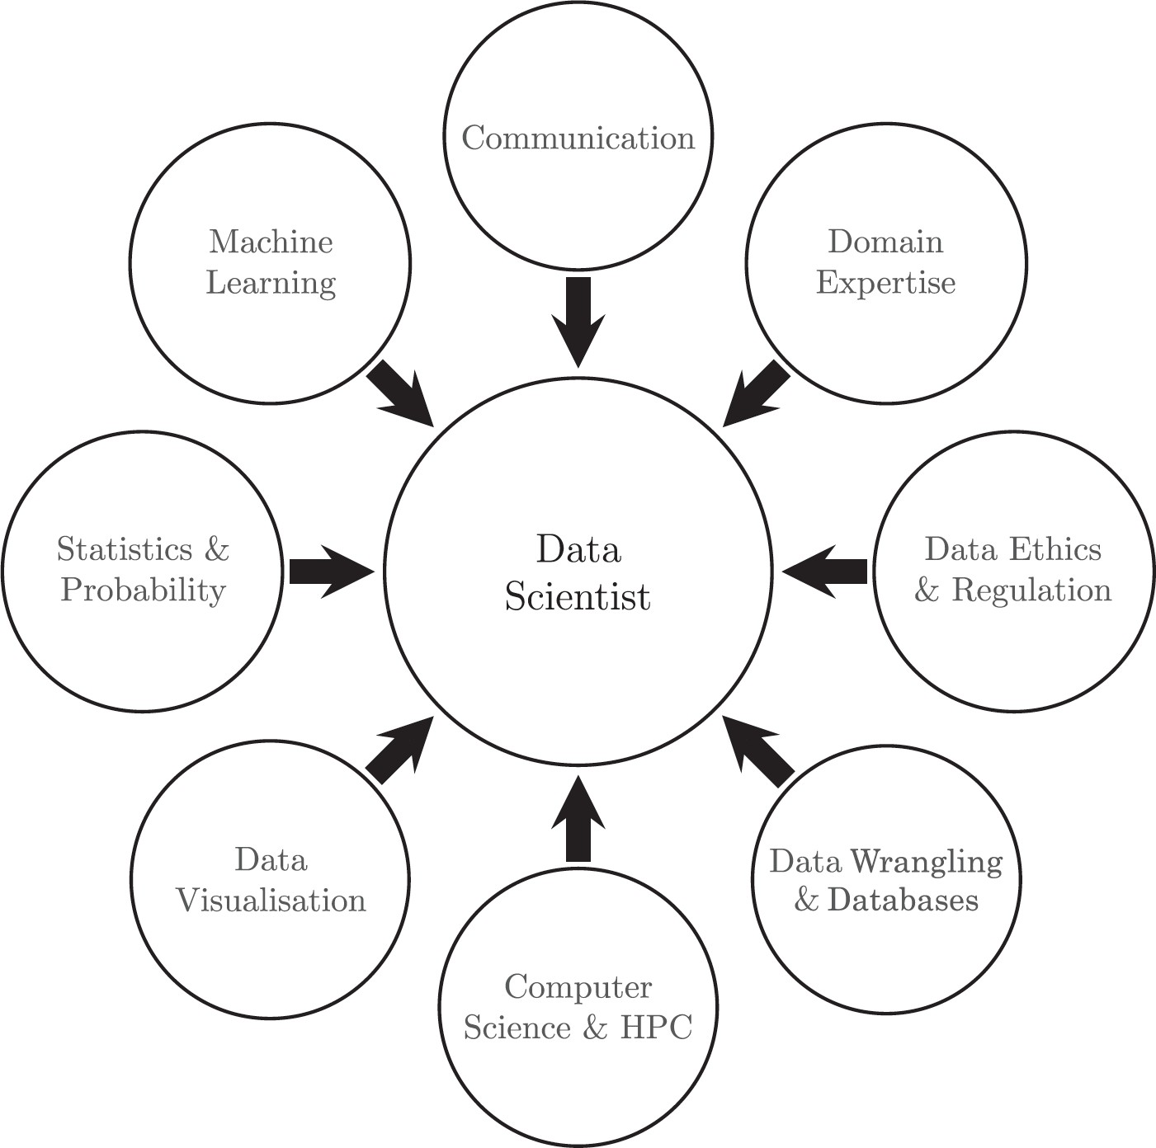
Skills of a Data Science

Slide 15
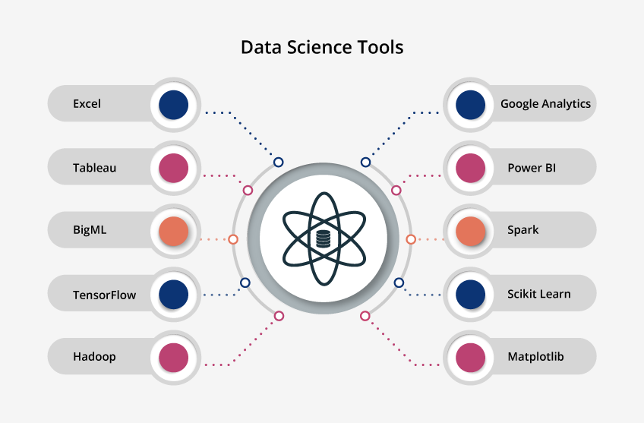

Slide 16
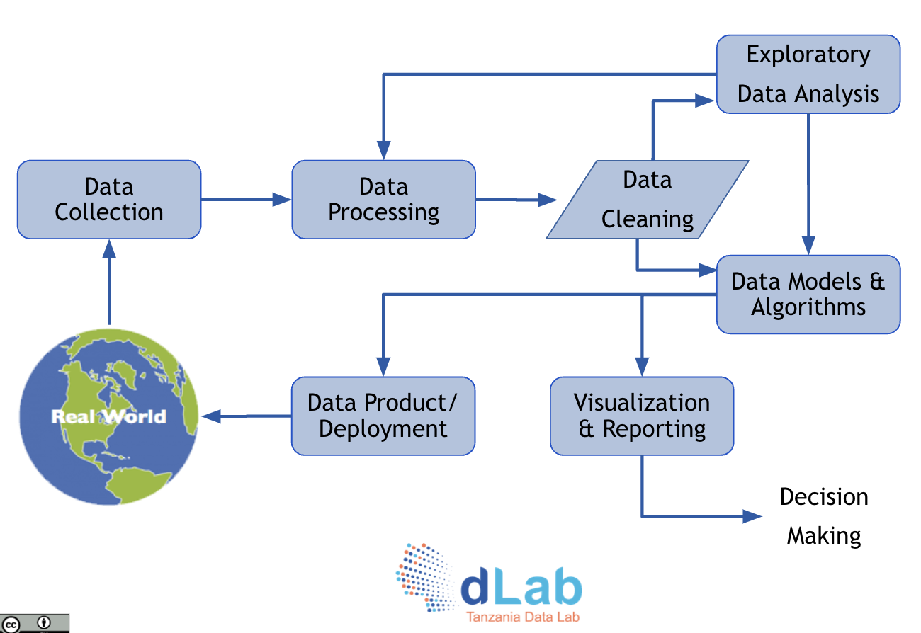
Data Science Life Cycle

Slide 17

Some challenges of Data Science
Ethics, Privacy and Trust
Missing data
Data access
Data science expertise – Due to the multi-disciplinary nature

Slide 18


Questions?

